Slide 1
Thoughts and comments
Check labels and annotations. Every image should have:
Major dimensions
Label
Tool to show operation

Slide 2
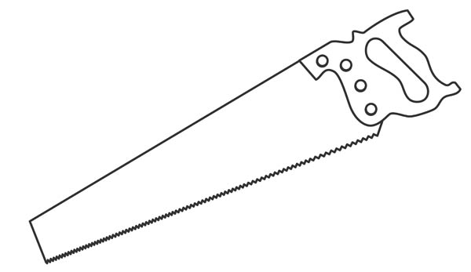

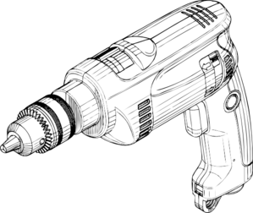

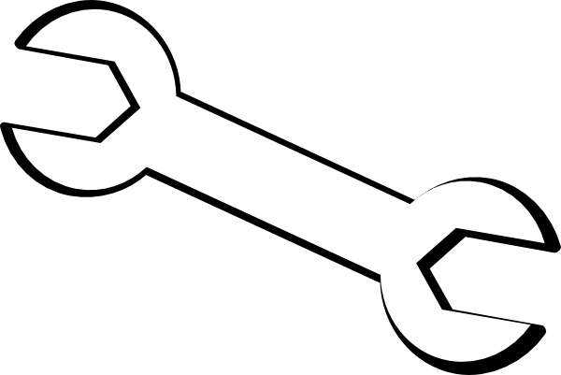

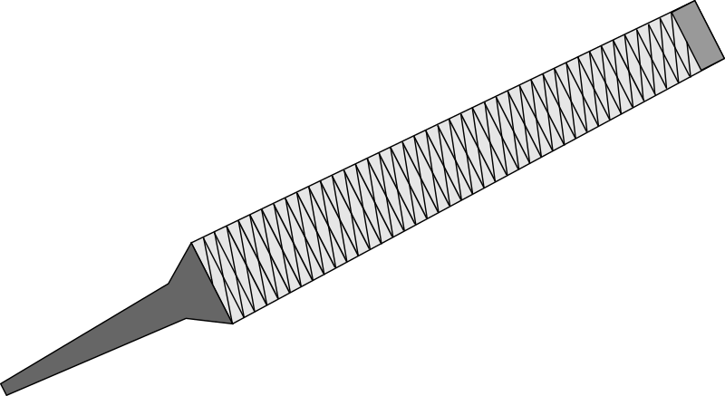
Tools Required
Saw |  | Protractor
Hand Drill |  | Ruler
Spanner (M5) |  | Tape Measure
File
Notes:
Would maybe be cool to have symbols for each tool and then use these to describe each operation. E.g. instead of saying ‘cut blades’, show symbol of cutting tool next to drawing of dimensions to be cut.

Slide 3
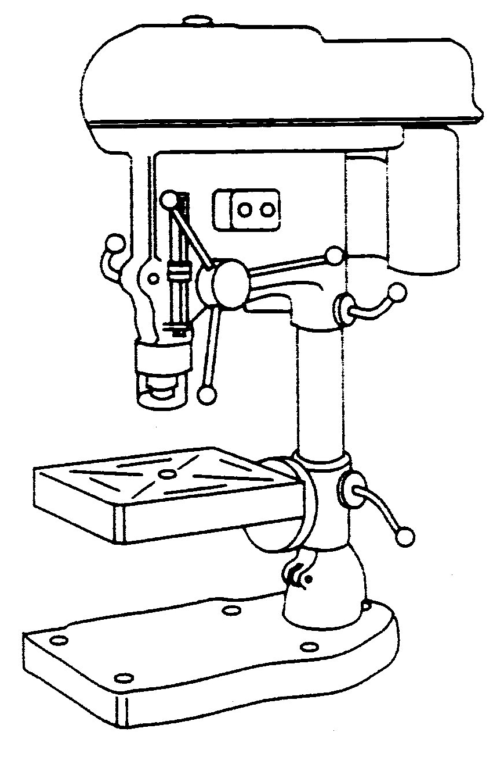
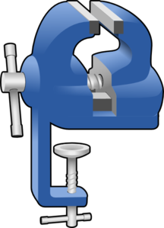
Optional Tools
Drill Press
Vice

Slide 4
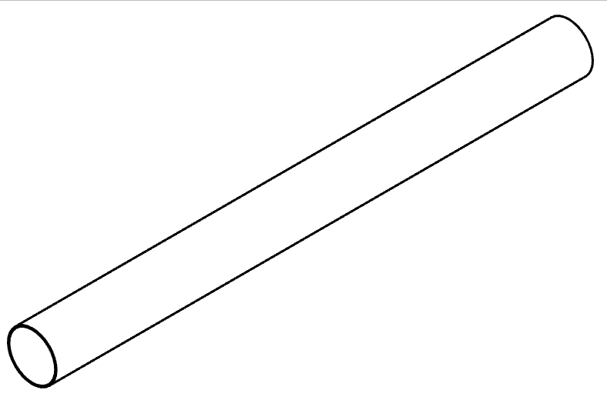
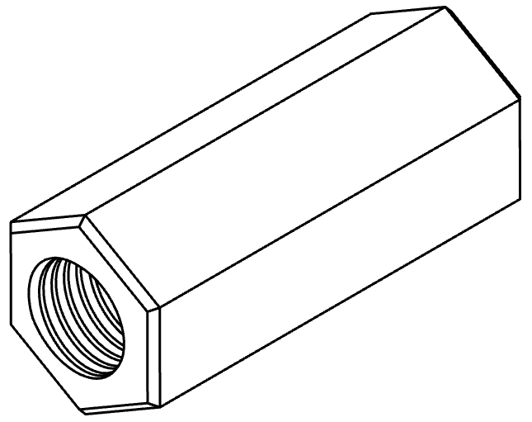
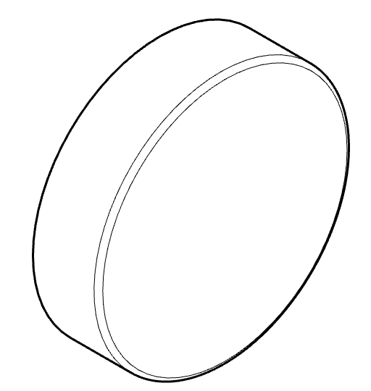
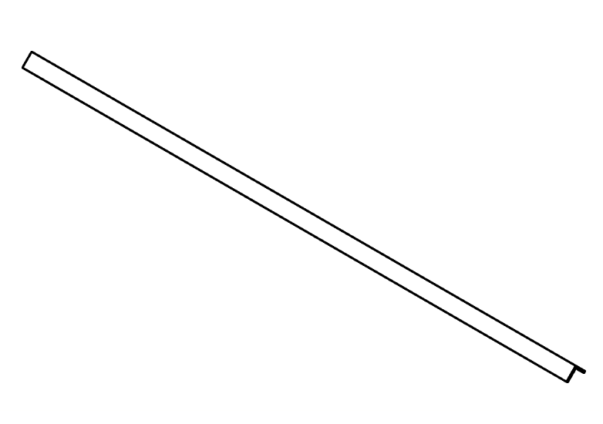
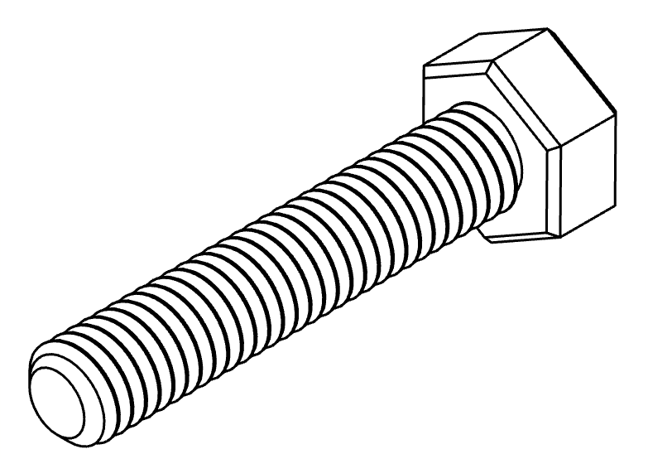
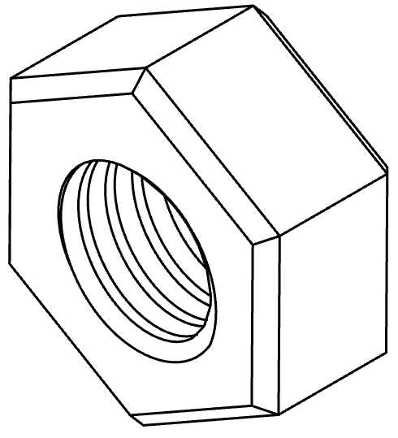
Materials | Qty |  | Materials | Qty
90mm PVC pipe (1m length) | 1 |  | M16x60mm threaded coupling | 1
100mm PVC end cap | 1 |  | 12x12x1.4mm Angle Iron (0.5m long) | 1
Bolts: M5x25mm M16x100mm | 10 1
Nuts: M5 M16 | 10 1

Slide 5
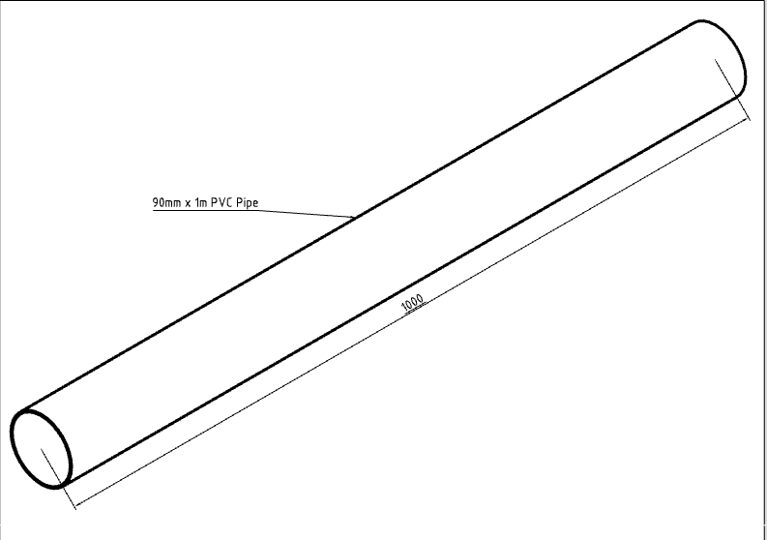
PVC can be a great material to make wind turbine blades. It is cheap, light and readily available at most hardware stores. To make blades that are 500mm long, you will want to start with a 1m length of 90mm PVC, which is approximately 2mm thick.

Slide 6
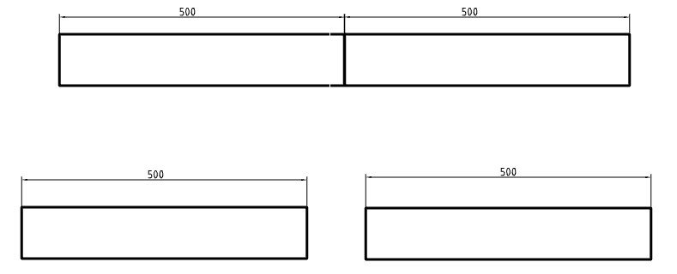
Step 1:
Measure and mark off 500mm from the end of the pipe. Then carefully cut through to make two equal lengths.

Slide 7
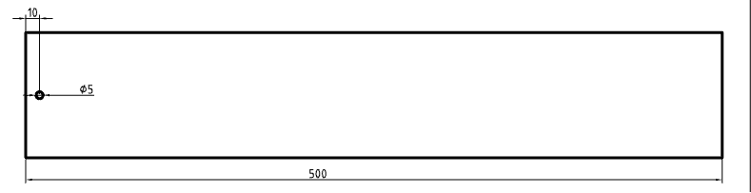
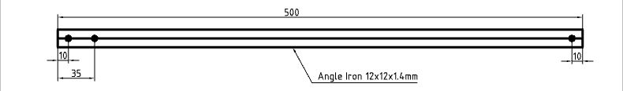
Step 2:
Drill a 5mm hole, 10mm from one end of the pipe. Rotate the pipe 90 degrees and repeat three more times.
Step 3:
Drill three holes in the centre of the angle iron as shown here:

Slide 8
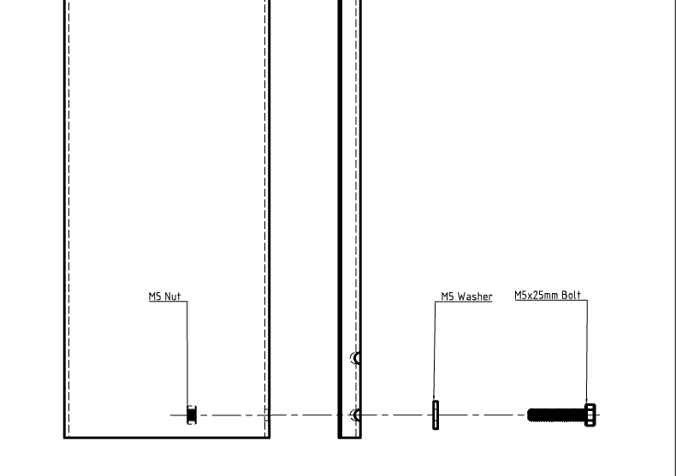
Step 4:
Loosely fasten the angle iron to the pipe using an M5 nut, bolt and washer. Lay the angle iron straight down the length of the pipe.

Slide 9
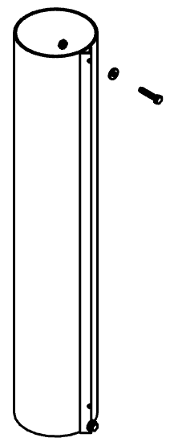
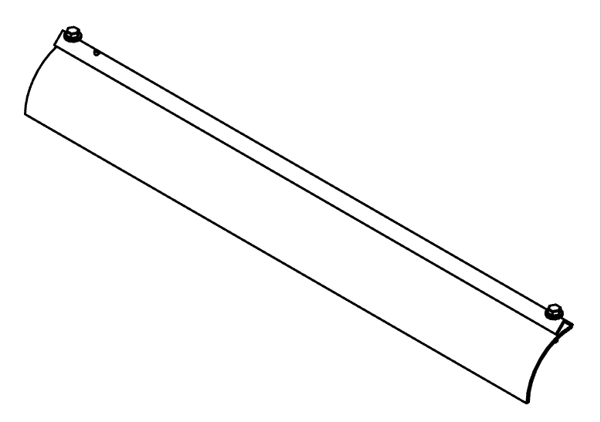
Step 5:
Drill a hole at the other end of the pipe using the hole in the angle iron and then fasten this end down as well.
Step 6:
Use the angle iron to make a straight cut down the pipe. Repeat this process until the pipe is in quarters.

Slide 10


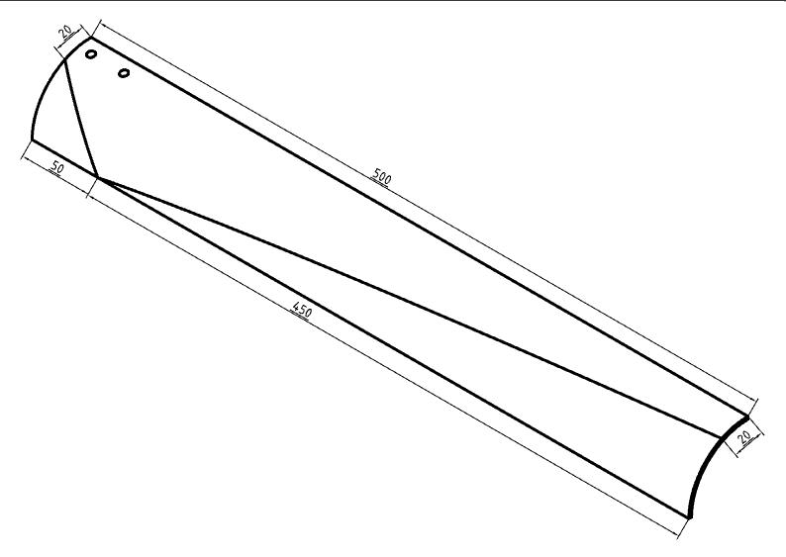
Step 7:
Measure the tip to be 20mm wide and then mark off a point 50mm from the other end. Using sticky tape, join these two parts with a straight line and make a cut to shape the blade.
Repeat this process for the tip using the dimensions shown. Note that it is difficult to cut accurately due to the shape of the blades, and so it is recommended to cut less than you think and then use a file and sandpaper to finish.
Notes:
I think this is in the wrong order. Makes sense to cut the root first as it’s a smaller cut.

Slide 11
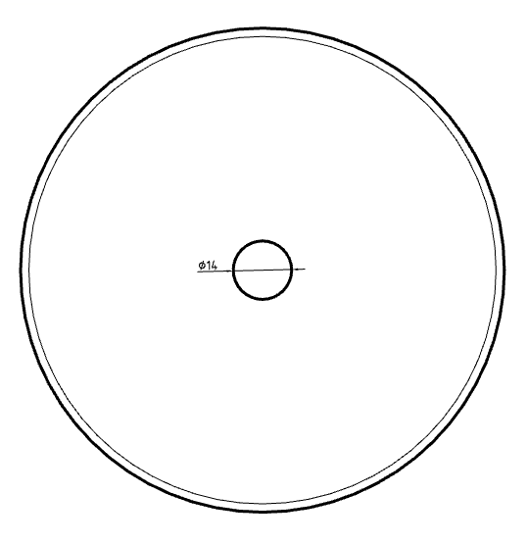
Step 8:
Find and mark off the centre of the 100mm PVC end cap. Use this mark to drill out a 14mm hole.

Slide 12
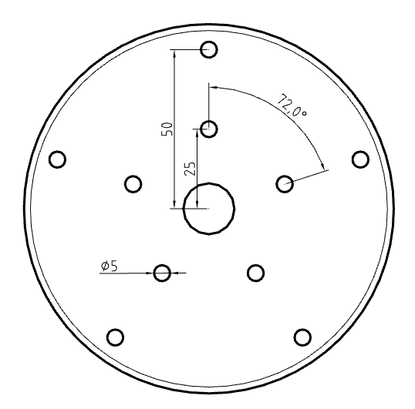
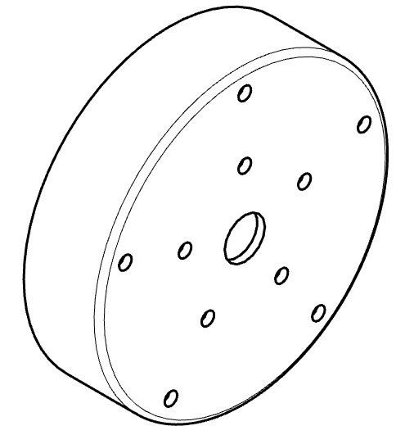
Step 9:
Drill out 5mm holes to attach the blades according to these dimensions.

Slide 13
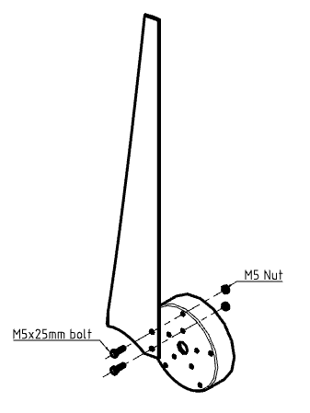
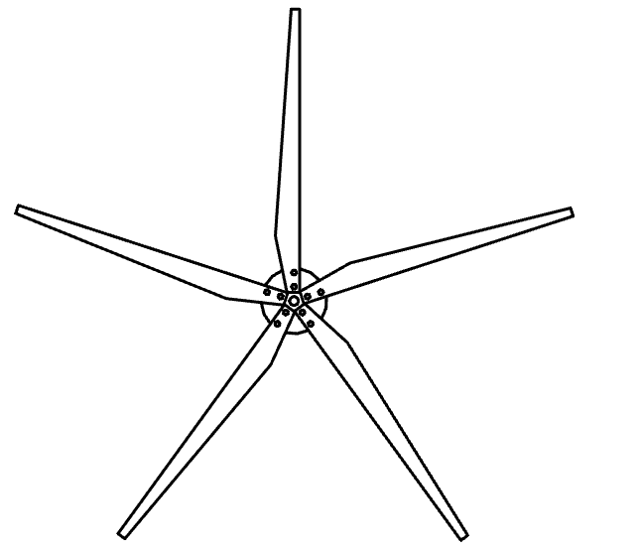
Step 12:
Attach each blade using 5mm bolts, washers and nylon locking nuts.

Slide 14
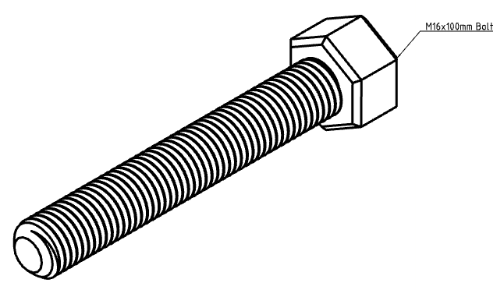
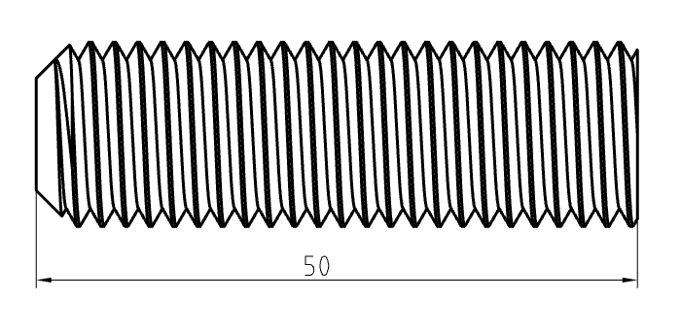
Step 13:
Cut off a 50mm length of the threaded shaft from an M16 bolt.

Slide 15
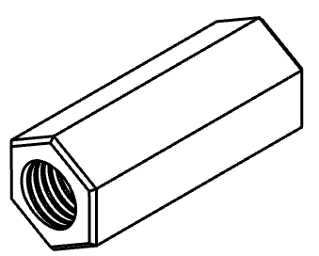
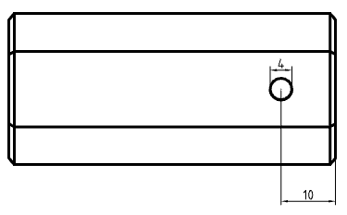
Step 14:
Drill a 4mm hole all the way through the M16 coupling, 10mm from one end.
Notes:
Add hole dimension to drawing
Add length dimension to view with hole
Add label to isometric view

Slide 16
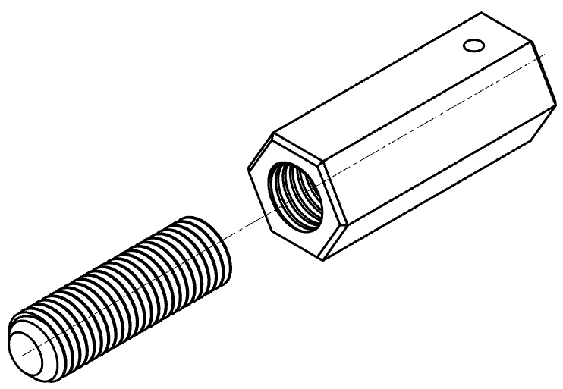
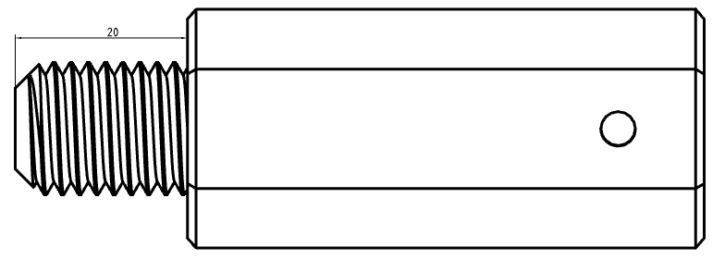
Step 15:
Apply superglue/threadlock and screw the M16 coupling and thread together so there is 20mm of thread exposed.

Slide 17
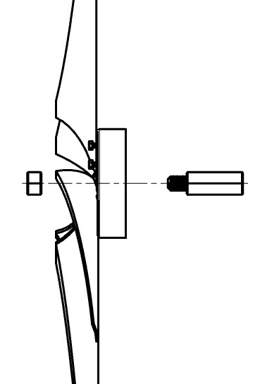
Step 16:
Fasten the whole blade assembly together, until really tight, using superglue or threadlock to hold the fasteners in place.

Slide 18
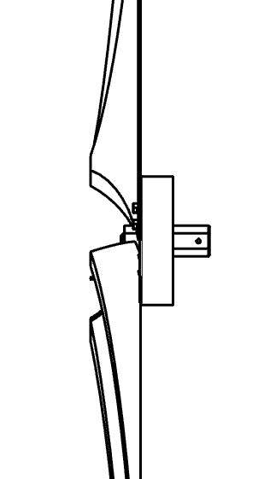
Marvel at your new blade assembly!

